Slide 1
8.1 Mathematical tools
Supporting class notes.

Slide 2
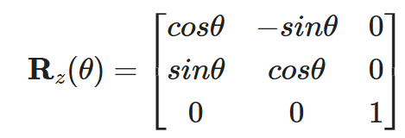


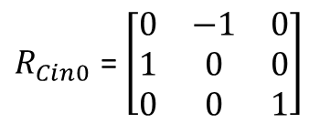

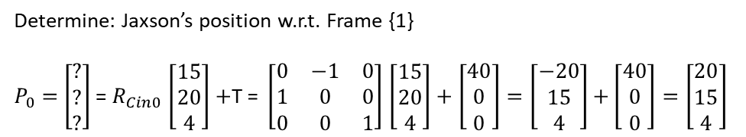
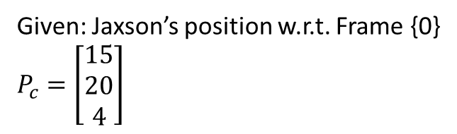



Given: Jaxson’s position w.r.t. Frame {0}
$P_{c}=$ $\left[\begin{matrix}15 \\ 20 \\ 4\end{matrix}\right]$
$R_{Cin0}$ = $\left[\begin{matrix}0 & −1 & 0 \\ 1 & 0 & 0 \\ 0 & 0 & 1\end{matrix}\right]$
Jaxson
Determine: Jaxson’s position w.r.t. Frame {1}
$P_{0}=$ $\left[\begin{matrix}? \\ ? \\ ?\end{matrix}\right]$ = $R_{Cin0}$ $\left[\begin{matrix}15 \\ 20 \\ 4\end{matrix}\right]+$T $\text{= }\left[\begin{matrix}0 & −1 & 0 \\ 1 & 0 & 0 \\ 0 & 0 & 1\end{matrix}\right]$ $\left[\begin{matrix}15 \\ 20 \\ 4\end{matrix}\right]+\left[\begin{matrix}40 \\ 0 \\ 0\end{matrix}\right]=\left[\begin{matrix}−20 \\ 15 \\ 4\end{matrix}\right]$ $+\left[\begin{matrix}40 \\ 0 \\ 0\end{matrix}\right]=\left[\begin{matrix}20 \\ 15 \\ 4\end{matrix}\right]$
(Orientation of frame {C}
15
$$Y_{0}$$
$$X_{C}$$
Instructor
$$Y_{C}$$
$$Z_{C}$$
$$Z_{0}$$
$$X_{0}$$
20
Frame {C}
Camera Frame
Frame {0}
Base frame, or World Frame, or Global Frame
Rotation of {C} w.r.t {0}: 90 degrees CCW about $Z_{0}$
Translation of {C} w.r.t {0}: 40 feet

